Slide 1
4CS015 Lecture 4: Arithmetic Logic Units

Slide 2
1. Today
What is an ALU?
Function Unit
Instruction Decoder
Output Multiplexor
Turning our adder into a subtractor
1. Today
2.What is ALU?

Slide 3
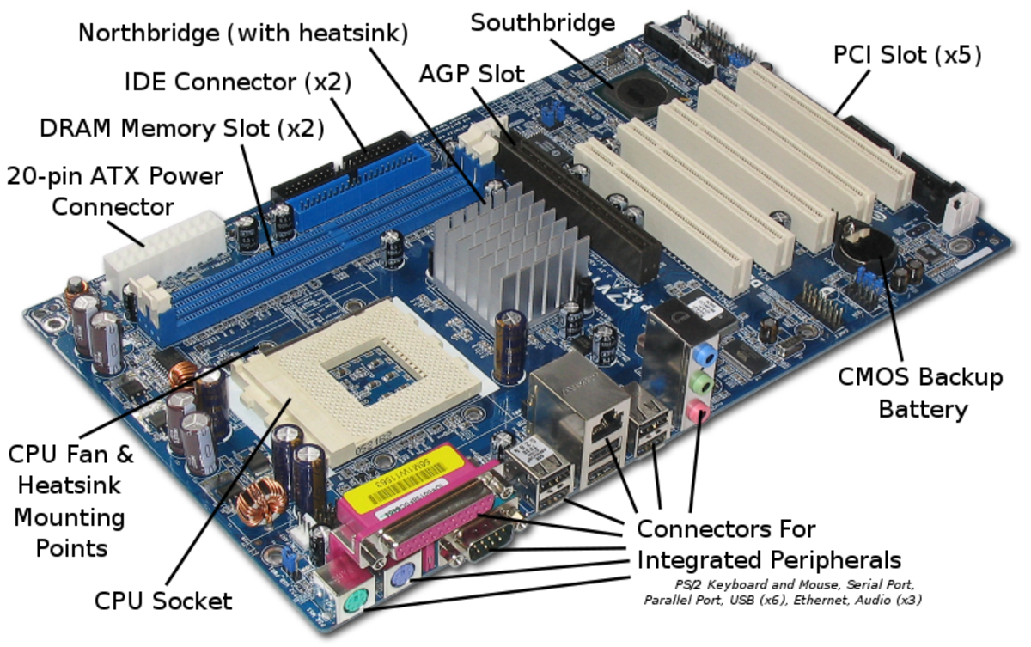
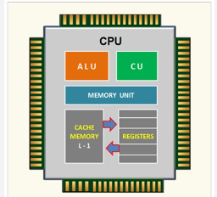
2. What is ALU?
ALU
2.What is ALU?
2.1 Arithmetic Logic Unit Diagram
2.2 The ALU
Fig: CPU
Fig: Motherboard

Slide 4
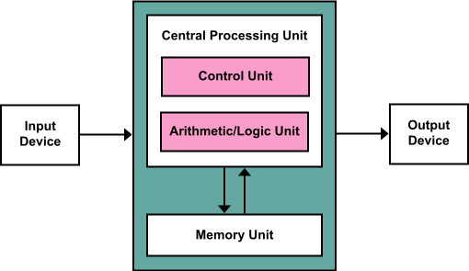
2. What is ALU?
Performs set of arithmetic operations and set of logic operations
Multi operation combinational logic circuit.
It has a number of selection lines to select particular operation in the unit.
2.What is ALU?
2.1 Arithmetic Logic Unit Diagram
2.2 The ALU

Slide 5
2.1 Arithmetic Logic Unit diagram
2.What is ALU?
2.1 Arithmetic Logic Unit Diagram
2.2 The ALU
Value 1 = 4
ALU
Result = 9
Value 2 = 5
Operation = ADD

Slide 6
2.2 The ALU
A function unit containing the logic blocks that simultaneously carry out each operation
A controller that selects the required output according to the instruction
The instruction is a binary ‘word’
A ‘switch’ that obeys the controller which connect the output to the required function
Switch
Function Unit
2.What is ALU?
2.1 Arithmetic Logic Unit Diagram
2.2 The ALU
1 bit
1 bit
ALU
Logic
1 bit
(Output)
Ctrl
Instr

Slide 7
3.1 ALU Arithmetic and Logic Functions
Output examples
AND
OR
NOT
XOR
Addition
The controller “decodes” the instruction to select the required output
3.1 ALU Arithmetic and Logic Functions
3.2 ALU Decoder and Output Selection
3.3 ALU Instruction Decoder
Output
1 bit
ALU
Logic
AND
1 bit
OR
NOT
XOR
Addition
Ctrl
Subtraction
Instr

Slide 8
3.2 ALU Decoder & Output Selection
Controller takes an instruction
Logic is used so that only one of the logic operation outputs reaches the result output.
3.1 ALU Arithmetic and Logic Functions
3.2 ALU Decoder and Output Selection
3.3 ALU Instruction Decoder
Output to ‘switch’
Binary
Instruction
Decoder
Ctrl

Slide 9
3.3. ALU Instruction Decoder
The decoder is a combinatorial logic circuit(CLC)
The circuit in which, at any time
output is only depends upon
inputs only is called CLC
It converts binary information
from ‘n’ i/p lines to a maximum of 2^{n} o/p lines
Multiple output lines, ctrl1 to clrl4
Only one of the output lines is ‘on’ for each instruction
‘n’ instruction lines = 2^{n} control lines. Hence size of decoder is n* 2^{n}
Instruction
Output
Inst1 | Inst2 | ctrl1 | ctrl2 | ctrl3 | ctrl4
0 | 0 | 1 | 0 | 0 | 0
0 | 1 | 0 | 1 | 0 | 0
1 | 0 | 0 | 0 | 1 | 0
1 | 1 | 0 | 0 | 0 | 1
3.1 ALU Arithmetic and Logic Functions
3.2 ALU Decoder and Output Selection
3.3 ALU Instruction Decoder

Slide 10
3.3 ALU Instruction Decoder (Contd.)
From the truth table, we can design a logic circuit.
Boolean expression for o/p is:
ctrl1=Inst1’Inst2’, ctrl2=Inst1’Inst2,
ctrl3=Inst1Inst2’ and ctrl4=Inst1Inst2
The arithmetic and logic function section performs all operations at the same time
So we use the controller to select the output we want
3.1 ALU Arithmetic and Logic Functions
3.2 ALU Decoder and Output Selection
3.3 ALU Instruction Decoder
Inst1
ctrl1
Inst2
ctrl2
ctrl3
ctrl4

Slide 11
4. ALU Output Multiplexor
If we have a collection of AND gates, connected to an OR gate, we have
a logic circuit for the multiplexer
Many to one
Selects the outputs with the help of decoder outputs
4. ALU Output Multiplexor
5. Half Adder (HA)
6.Full Adder (FA)
Lines from ALU logic Block
Output
Control lines
from decoder
Lines form Decoder output

Slide 12
5. Half Adder (HA)
x
s
Two bit adder circuit
Number of inputs = 2 (x and y ‘say’)
Number of outputs= 2 (sum and carry)
For example:
0 0 1 1
+0 +1 +0 +1
0 1 1 10
HA
4. ALU Output Multiplexor
5. Half Adder (HA)
6.Full Adder (FA)
y
c
Input
Output
x | y | Sum(s) | Carry(c)
0 | 0 | 0 | 0
0 | 1 | 1 | 0
1 | 0 | 1 | 0
1 | 1 | 0 | 1
sum
carry

Slide 13
5. Half Adder (Contd…)
Boolean expression for half adder output from truth table is as;
Sum(s)= x’y+xy’ =(x⊕y)
Carry(c)=xy
Logic diagram
4. ALU Output Multiplexor
5. Half Adder (HA)
6.Full Adder (FA)
x
(x⊕y)
Sum
y
xy
Carry

Slide 14
6. Full Adder (FA)
Three bit adder circuit
Number of input= 3(x,y and c_{in} )
Number of output =2(sum and carry)
FA can be constructed using two HA and OR gate
Block diagram
4. ALU Output Multiplexor
5. Half Adder (HA)
6.Full Adder (FA)
s
x
s
x
HA-1
HA-2
c
y
c
y
c_{in}
c

Slide 15
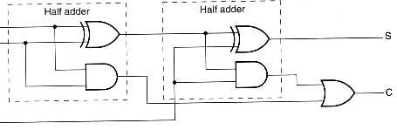
6.1 Logic circuit diagram of FA
6.Full Adder (FA)
6.1 Logic circuit diagram of FA
x
x⊕y
(x⊕y⊕ c_{in})
y
(x⊕y) c_{in}
xy
xy
c_{in}

Slide 16
7. ALU Components: Contd.
Function Unit/ALU Logic
Multiplexer(MUX)
Operations
Multiplexor
A
AND
7. ALU Components: Contd.
8.Multi Bit ALU
9.Subtraction
B
OR
XOR
Output
Full Adder
Circuit
Addition
Carry in
Carry out
Inst1
ctrl1
Inst2
ctrl2
ctrl3
ctrl4
Decoder
Decoder

Slide 17
8. Multi Bit ALU
Carry out(C)
Connect multiple single bit ALUs together
The ‘carry out’ of each ALU links to ‘carry in’ of next ALU
Final result is CR2R1R0
A2
R2
B2
7. ALU Components: Contd.
8.Multi Bit ALU
9.Subtraction
Carry out to carry in
A1
R1
B1
Carry out to carry in
A0
R0
B0
Instructions
Carry in

Slide 18
9. Subtraction
Subtraction can be done by adding A to the 2’s complement form of B.
S = A+(2’s Complement of B)
=A+(1’s complement of B+1)
=A+(B’+1)
The rule to convert B to –B in 2’s complement form is:
Invert each bit (using NOT gates).
Add 1.
8.Multi Bit ALU
9.Subtraction
10. Add/ Subtract Circuit

Slide 19
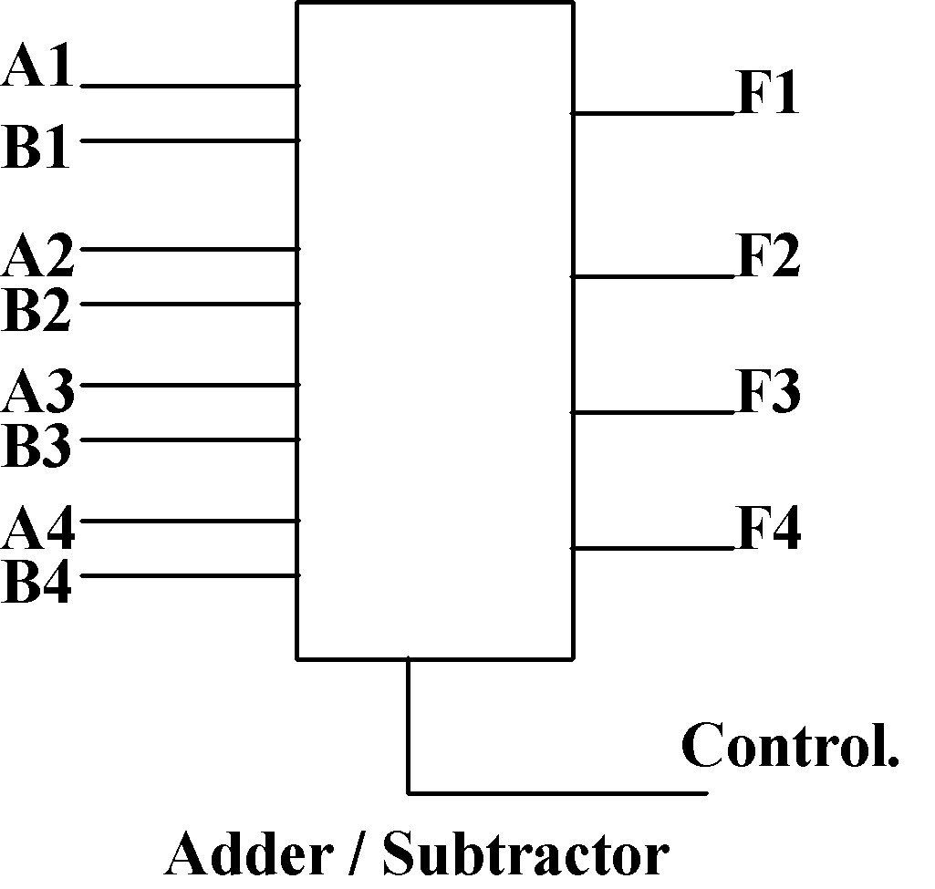
10. Add / Subtract Circuit
Both addition and subtraction circuits can be combined into a single circuit by using Controlled Inversion.
A Control input determines whether the circuit adds or subtracts.
9.Subtraction
10. Add/ Subtract Circuit
11. Controlled Inversion

Slide 20
11. Controlled Inversion
Consider the following truth table:
Input Control will be the CONTROL.
Input B is the Data.
9.Subtraction
10. Add/ Subtract Circuit
11. Controlled Inversion
12.Circuit for Add/ Subtract Unit
Input Control | Input B | Output F
0 | 0 | 0
0 | 1 | 1
1 | 0 | 1
1 | 1 | 0
Output F=B= B
Output F=B’ NOT B

Slide 21

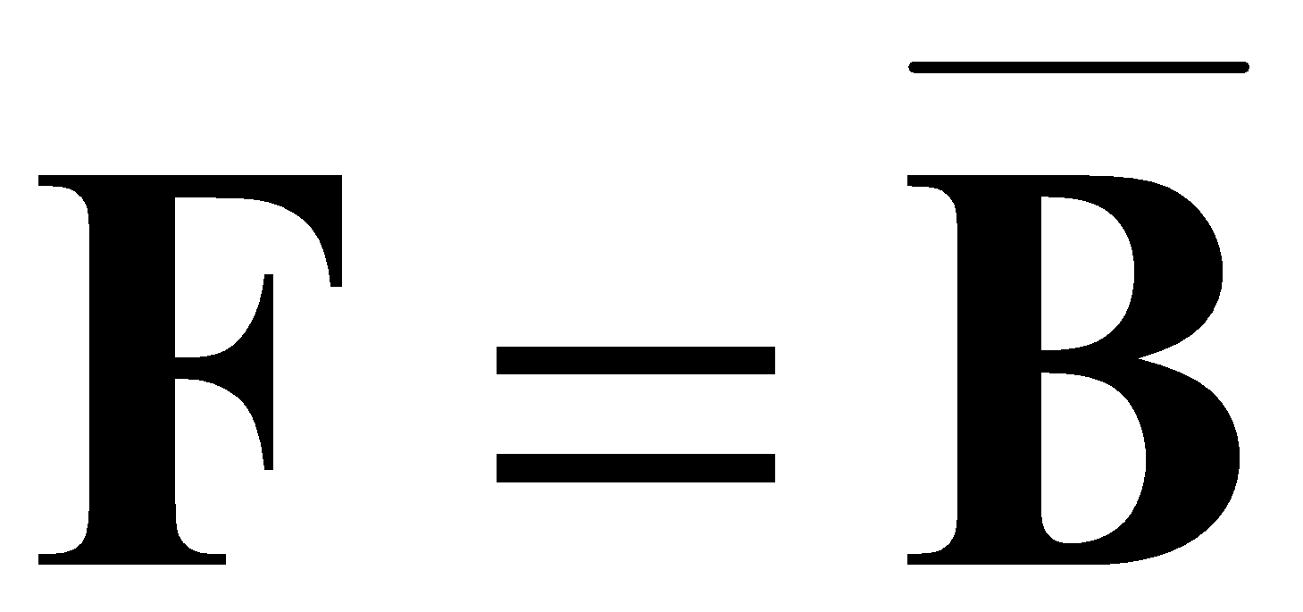
11. Controlled Inversion (Contd.)
When Control = 0
Then
When Control = 1
Then
This is the truth table for XOR
9.Subtraction
10. Add/ Subtract Circuit
11. Controlled Inversion
12.Circuit for Add/ Subtract Unit
Control | Input B | Output F
0 | 0 | 0
0 | 1 | 1
1 | 0 | 1
1 | 1 | 0

Slide 22
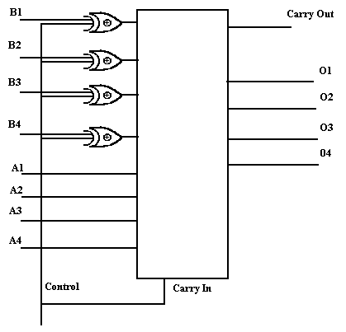
12. Circuit for Add / Subtract Unit
Input Control | Input B | Output F
0 | 0 | 0
0 | 1 | 1
1 | 0 | 1
1 | 1 | 0
10. Add/ Subtract Circuit
11. Controlled Inversion
12.Circuit for Add/ Subtract Unit
13. Control of the Add/ Subtract Unit
Output F=B= B
4-bit adder
Output F=B’ NOT B
0/1

Slide 23
13. Control of the Add / Subtract Unit
The Control determines the operation:
Control = 0 : Addition
Carry-in is 0 .
Output is A plus B plus 0.
Control = 1 : Subtraction
Carry-in is 1.
Output is A plus ( inverse of B plus 1).
which is A plus (-B).
12.Circuit for Add/ Subtract Unit
13. Control of the Add/ Subtract Unit
14. Summary

Slide 24
14. Summary
ALU
Functions, controlling and multiplexing.
Controlled inversion and subtraction.
12.Circuit for Add/ Subtract Unit
13. Control of the Add/ Subtract Unit
14. Summary

Slide 25


